Slide 1
Mailbox Nofitier
By David Sørensen

Slide 2

Mail or not?
The struggle not knowing when we got mail

Slide 3

Mailbox Notifier
Detect when the mailslot has been open
Notify you by visial and online
When your comming or going
When you didn’t notice the postman or is simply not home.
Tell system you got your mail
Online
Restarting system

Slide 4
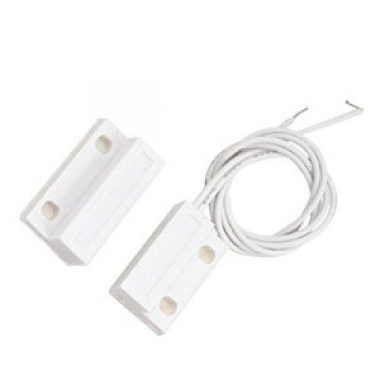
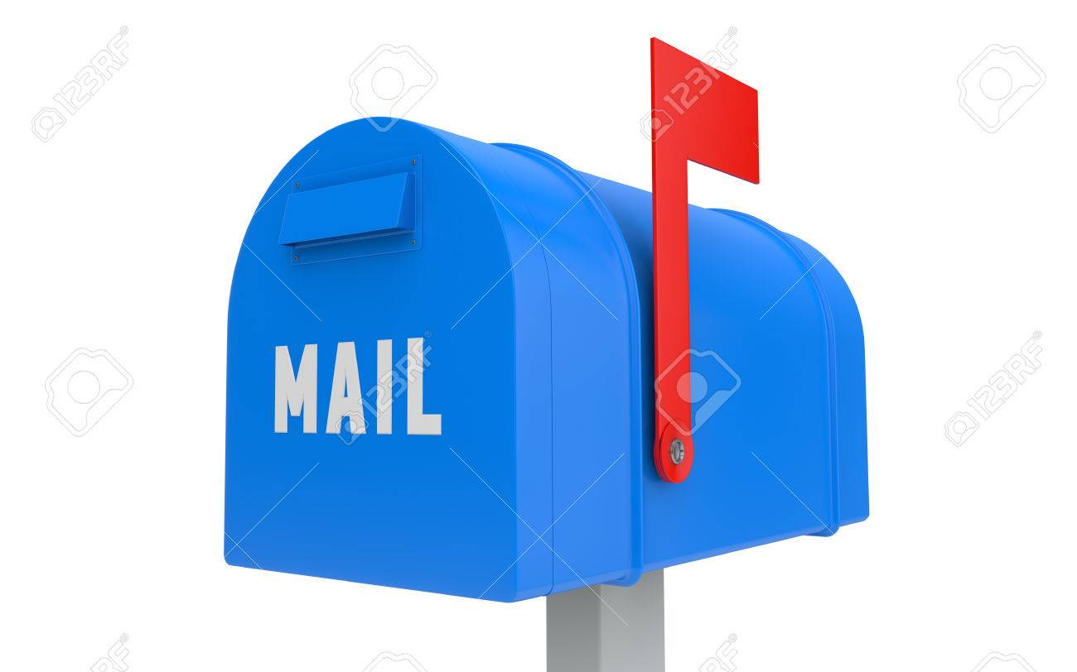
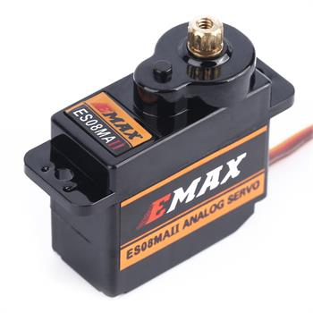
Hardware
Sensor to register an open mailslot
Servomotor to set flag
Notes:
Magnetic contact
Servomotor

Slide 5

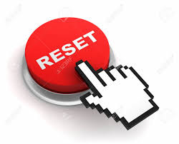
Internet
Send message to user
Reset system through internet

Slide 6
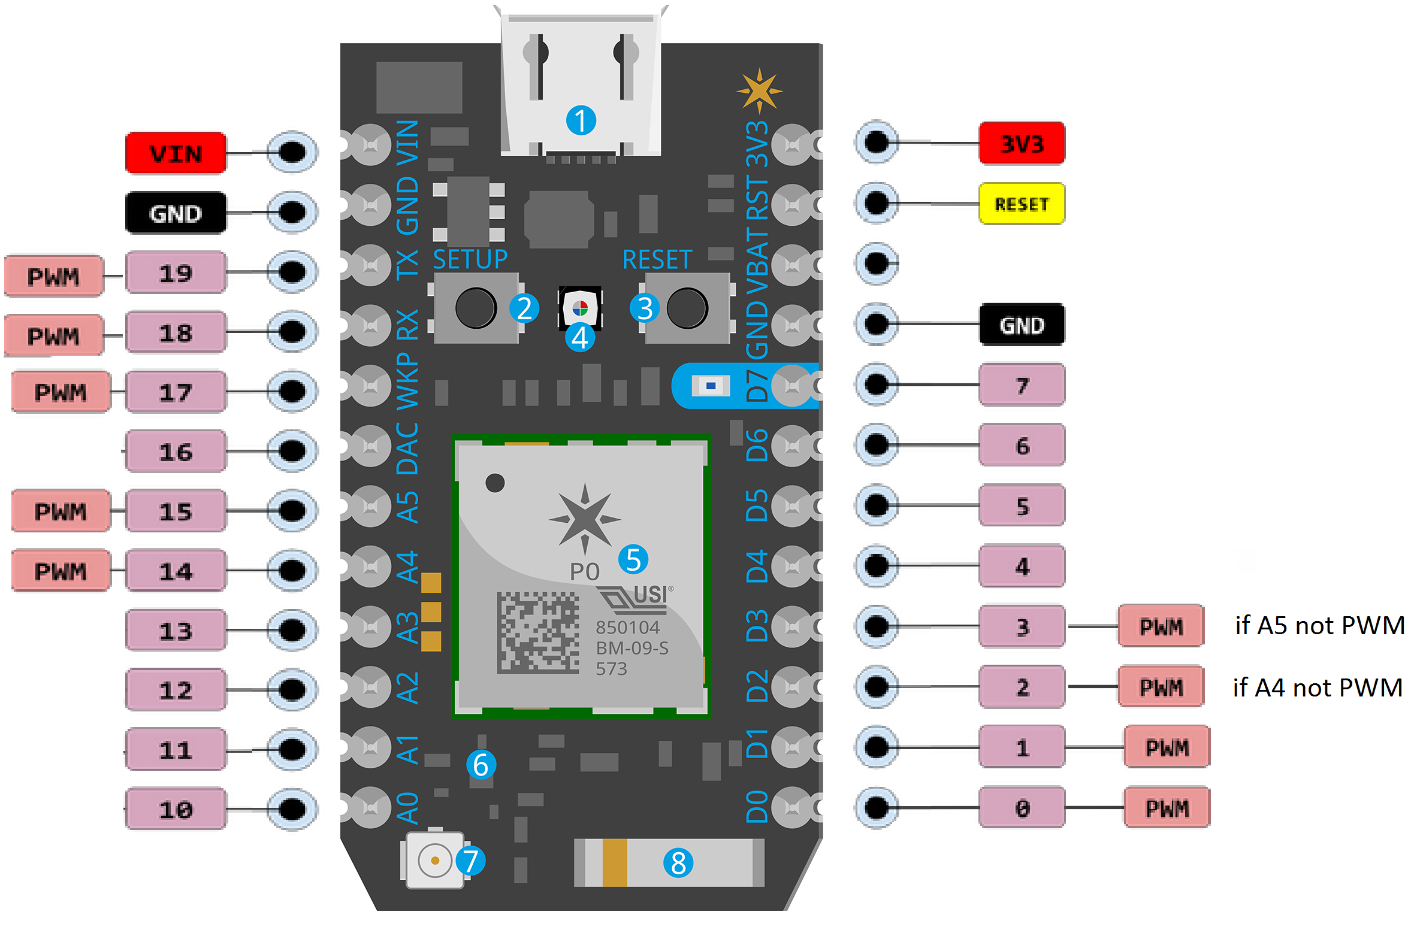
Particle photon
Notes:
D0-D7 er digitale pins, som kan bruges til sensoren
PWM skal bruges til servomotoren

